Slide 1


Slide 2
Project Title:
URL Shortener with Click Analytics (Multi-Region)
Presented By: Basheer Ahmad
Subject: System Design

Slide 3
Introduction
A URL shortener converts long links into short, shareable URLs
Used widely in marketing, social media, apps
My project also provides Click Analytics:
  Click count
  Geo-location
  Device information
  Referrer
Built for global performance using Multi-Region design

Slide 4
Requirements Pack :
This project aims to build a scalable multi-region URL shortener system.
Stakeholders include marketers, developers, end-users, and analytics teams.
Marketers need reliable analytics, while developers need strong APIs.
End users want fast, always-available short links.
Functional requirements include creating, redirecting, and tracking URLs.
Non-functional requirements include <50ms redirect latency and 99.99% uptime.
Constraints include no ID collisions and efficient handling of global traffic.
Assumptions: stable internet, DNS/Anycast usage, scalable cloud infra.
Prioritization gives highest weight to performance, availability, analytics accuracy.

Slide 5
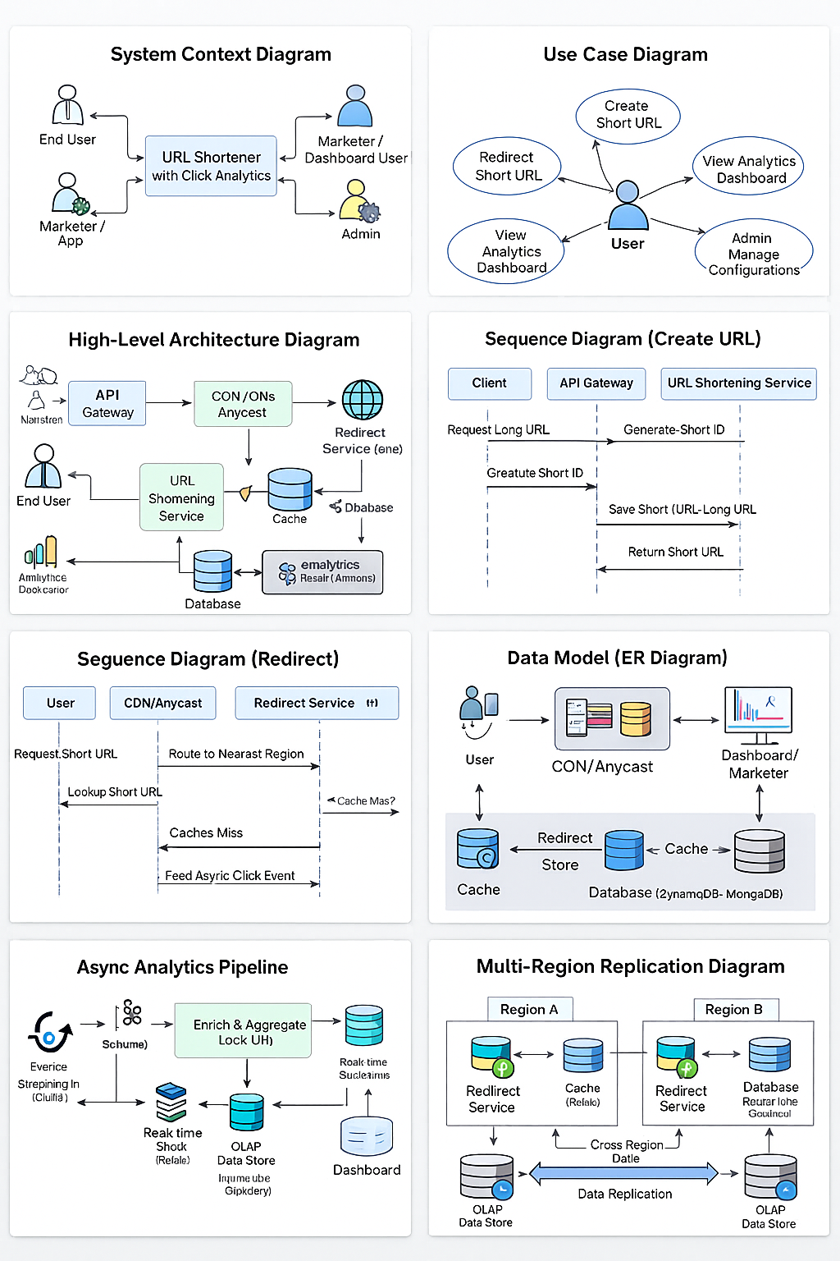
Diagram overview:

Slide 6
Diagrams Overview :
The project requires multiple architecture and design diagrams.
System Context Diagram shows how external actors interact with the system.
Use Case Diagram displays all major user functions like create/redirect/stats.
User Stories describe actions from the user perspective without technical details.
Core Sequence Diagrams show step-by-step URL creation and redirection flows.
High-Level Architecture covers services, API gateway, databases, and cache.
It also includes message queues, streaming systems, and CDN components.
Together, these diagrams provide a complete understanding of the system.
They help in communicating design clarity and system interactions.

Slide 7
Engineering Notes :
Capacity planning estimates millions of clicks and thousands of URL writes.
Back-of-envelope sizing defines cache size, DB throughput, and queue load.
API specs define Create URL, Redirect URL, and Stats endpoints.
Data model includes Links, Click Events, and Aggregated Statistics tables.
Consistency choices: strong for redirects, eventual for analytics.
Caching uses Redis for hot-URL lookups to reduce latency.
Indexing optimizes queries on short_id, timestamps, and referrer fields.
Resiliency uses retries, timeouts, load balancers, and circuit breakers.
Observability includes logs, metrics, traces, and dashboards for insight.

Slide 8
Quality Targets:
Redirect latency target: P95 under 50ms.
API latency target under 150ms for URL creation.
System availability target is 99.99% globally.
Scalability is achieved through sharding and multi-region deployments.
Partitioning of analytics data improves query performance.
SLOs define clear reliability expectations for each component.
SLIs measure redirect time, error rate, and cache hit ratio.
Trade-offs include cost vs availability, strong vs eventual consistency.
The design prioritizes user experience and operational stability.

Slide 9
Architecture Summary :
System uses microservices: URL Shortener, Redirect Service, Analytics Service.
CDN handles global caching and nearest-region routing.
Redis cache enables quick redirects with minimal DB hits.
NoSQL DB stores mappings and scales horizontally.
Kafka handles high-volume analytics events.
Stream processor enriches click data with geo/device details.
OLAP database supports dashboards and reports.
API gateway secures and routes all user and app traffic.
Overall architecture supports scalability, speed, and global reach.

Slide 10
Conclusion :
The system provides fast, reliable URL shortening with real-time analytics.
Multi-region deployment ensures users get global low latency.
Analytics pipeline gives marketers detailed insights.
Scalable architecture supports millions of clicks per day.
Strong caching strategy improves speed and reduces DB load.
High availability design ensures 99.99% uptime.
Event-driven architecture improves throughput and flexibility.
This project demonstrates strong system design principles.
It is suitable for enterprise-level real-world applications.

Slide 11


